Slide 1
Name: Md. Mahfuzur Rahman Roll No : 180134 Session : 2017-18 Dept. of CSE, PUST
Lab Report : 01
Course Name : Digital Signal Processing Sessional
Course Code : CSE-3208

Slide 2
Project name: Noise Cancelation Noise Removal from Audio
Import various library function.
Connected google drive which have stored audio file like m4a.
File source: /content/drive/MyDrive/sound/mahfuz2_withoutac.m4a.
The Audio file is displayed in google Colab.
The Audio file time duration in 15 seconds. That is have original signal
and noisy signal. This noisy signal is separated from original signal

Slide 3
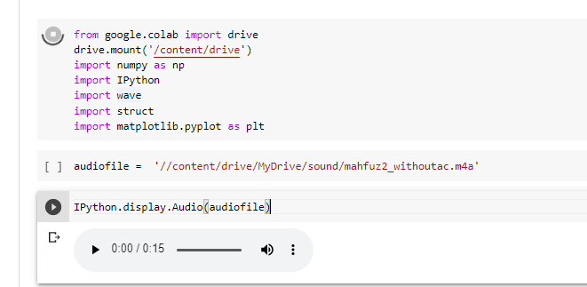
The library function, audio file and display the audio file code and output is given below: The audio file is .m4a file like mahfuz2_withoutac.m4a

Slide 4
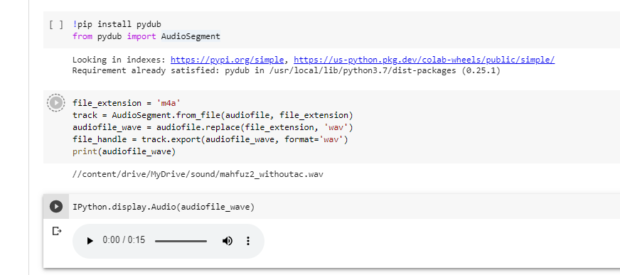
The .m4a audio file Convert into .wav format. Since the original file is m4a format, we need to convert it in wav format for performing any operations. Install pydub library function. The .wav audio file like mahfuz2_withoutac.wav

Slide 5
Reading wav file
Channels: A standard wave file consist of 2 channels. One is single channels and another double channel.
Each Channel sample is stored as a 16bit Signed number Hence can have range like -32768 to +32767
Sample rate: The audio signals are analog, but we want to represent them digitally. Meaning we want to discretize them in value and in time. The sample rate gives how many times per second we get a value. The unit is Hz.
The sample rate needs to be at least double of the highest frequency in the original sound [Based on Nyquist theorm which states that to retain frequency f we should sample at rate 2f, otherwise you get aliasing.
Human hearing range goes from ~20Hz to ~20kHz, so you can cut off anything above 20kHZ. Meaning a sample rate of more than 40kHz does not make much sense

Slide 6
Reading wav file
Bit-depth: The higher the bit-depth, the more dynamic range can be captured. Dynamic range is the difference between the quietest and loudest volume of an instrument, part or piece of music. A typical value seems to be 16 bit or 24 bit. A bit-depth of 16 bit has a theoretical dynamic range of 96 dB, whereas 24 bit has a dynamic range of 144 dB (source).
Subtype: PCM_16 means 16 bit depth, where PCM stands for Pulse-Code Modulation.
Min value : -32426 and Max value : 32767

Slide 7
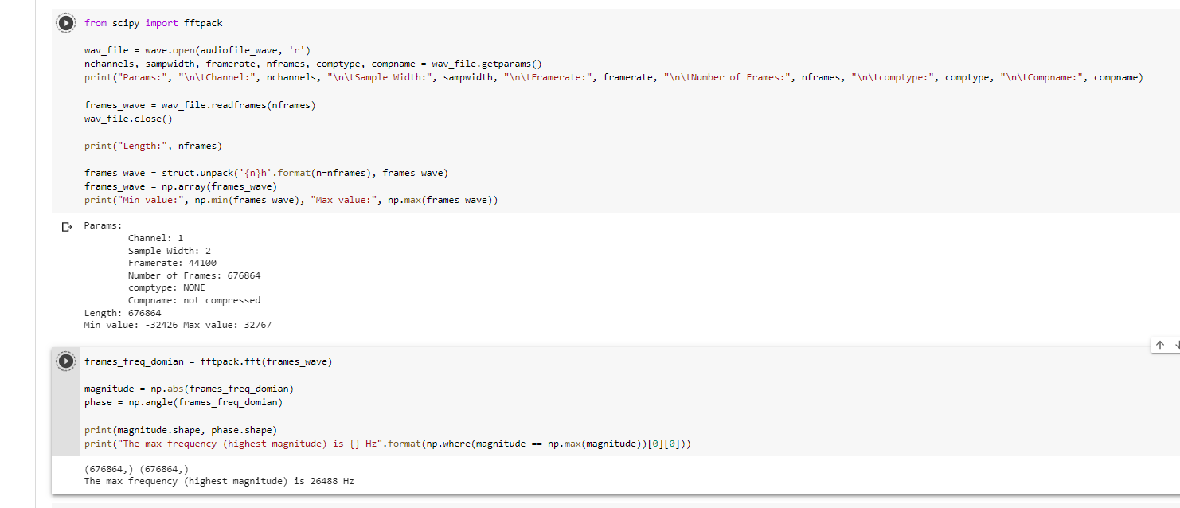
Reading wav format data from wav file and Deserializing.

Slide 8
Applying Fourier
The response of a filter for a single frequency can be expressed as a complex number such that it represent 2 parts of wave (Amplitude and Phase), where the angle is the phase response of the filter and the absolute value the magnitude response.
The Role is :
Amplitude*e^(i*phase) = amplitude*cos(phase)+i*amplitude*sin(phase)
Fast Fourier Transform
The Value is complex number but we want absolute number and frequency.
Normalizing Magnitude three different subplot.
If we have not limited the output to 44100 Hz in Frequency domain plot, you would have notice that first half and second half are almost same, complex conjugate (due to above and below sin waves).
Since human being can only hear up to 44100Hz Frequency we are not interested in above ranges.

Slide 9
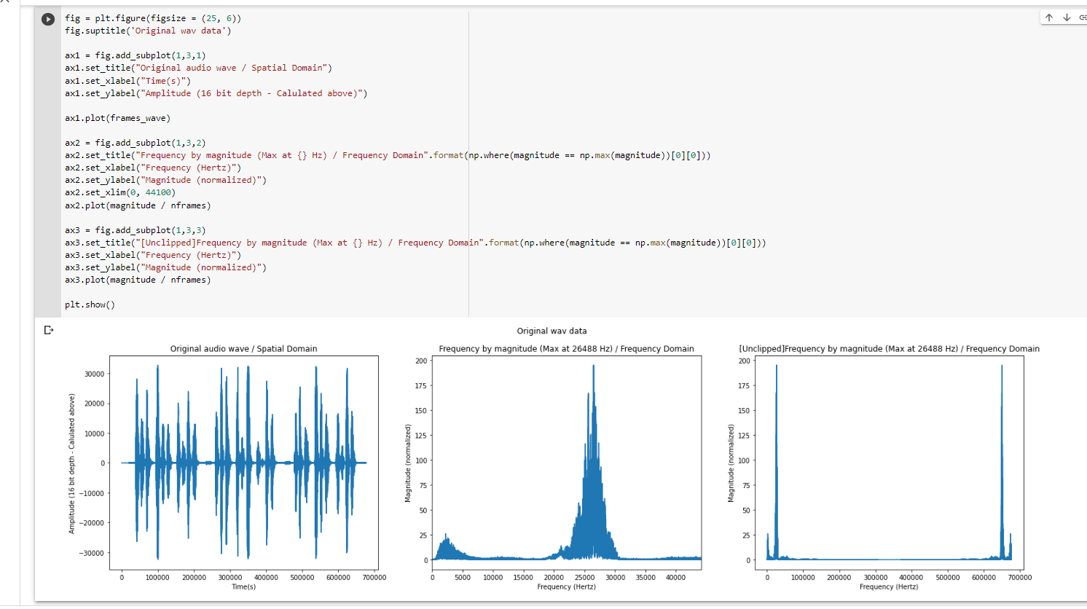
Applying Fourier

Slide 10
Filtering the signal
Sound can be expressed in terms of waves, which in turn have frequency components. If we mask some frequency, we can remove noise. Which frequency to mask is the matter of trial and error. Since we don’t have past data to train on it cannot be a ML based task.
In simplicity we want to allow a certain range of frequency and mask other, like applying a rectangular window over the whole signal. Now sinc function representation in frequency domain is a rectangle , we can use it as an ideal filter. We just need to place this over our signal in frequency domain and multiply (Amplitude modulation), then take a IFFT and get filtered singal back.

Slide 11
Filtering the signal
But based on nature of sinc it is not possible since it never reaches zero and if we have to use this we need to calculate value till infinity. So we can take a approximation here and settle with something in between.
Now above is just a explanation and their are many filters and their types. scipy comes with lots of them already built in and their is no need to dive in the maths, we just need to use the functions exposed.
Filters never add any new frequency components to the sound. They can only scale the amplitudes of already existing frequencies.

Slide 12
Filtering the signal
Import library function scipy and signal and buffer pass filter
It has Nyquest frequency. A fraction is 0 and 1 of sample rate
We get the filter coefficients so we can check that’s frequency response
The response is plot type like plot/subplot
It using signal freqz and abs.
The sample framerate of sample rate (Hz) and desired cutoff frequency of filter(Hz).

Slide 13
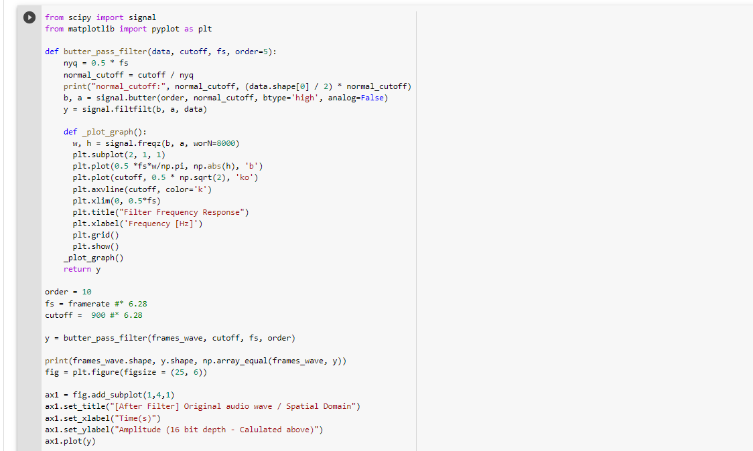
Filtering the signal

Slide 14
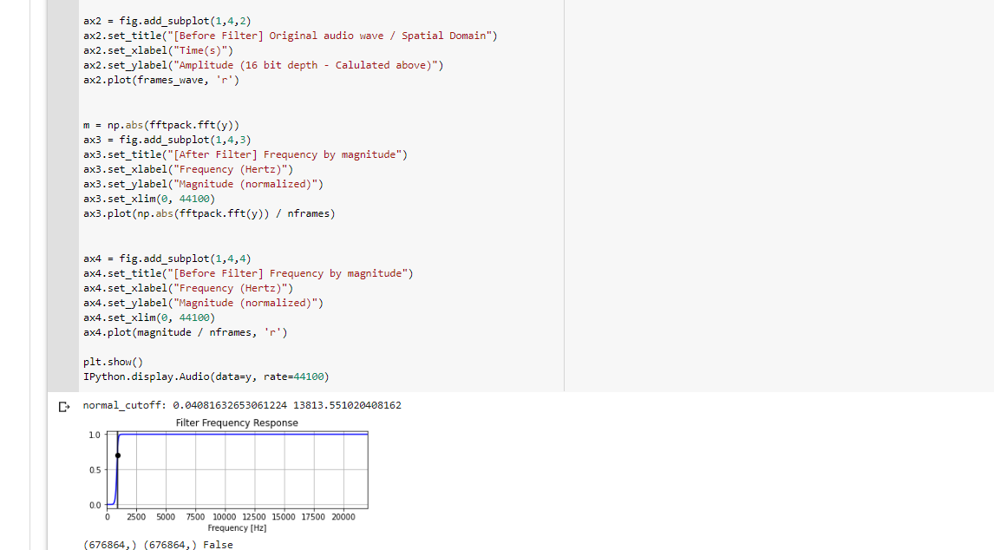
Filtering the signal

Slide 15
Writing Filtered signal back to file
The filtered signal is mahfuz1_filtered.wav
The filtered file is write mood, ‘w’
It is using various tuple like nchannels, sampwidth, framerate, nframes, comptype, compname and struct that is Python library which takes our data ans packs it as binary data.
The signal is filterd , it has no noisy signal, it’s pure signal.
So at last, we are completed successfully and separate noisy signan and also given fresh signal.

Slide 16
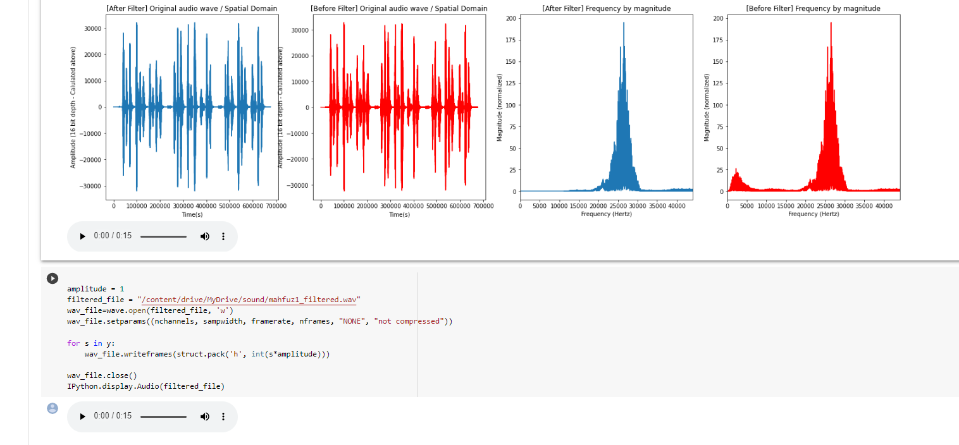
Filtered signal and without noisy sounds

